Slide 1
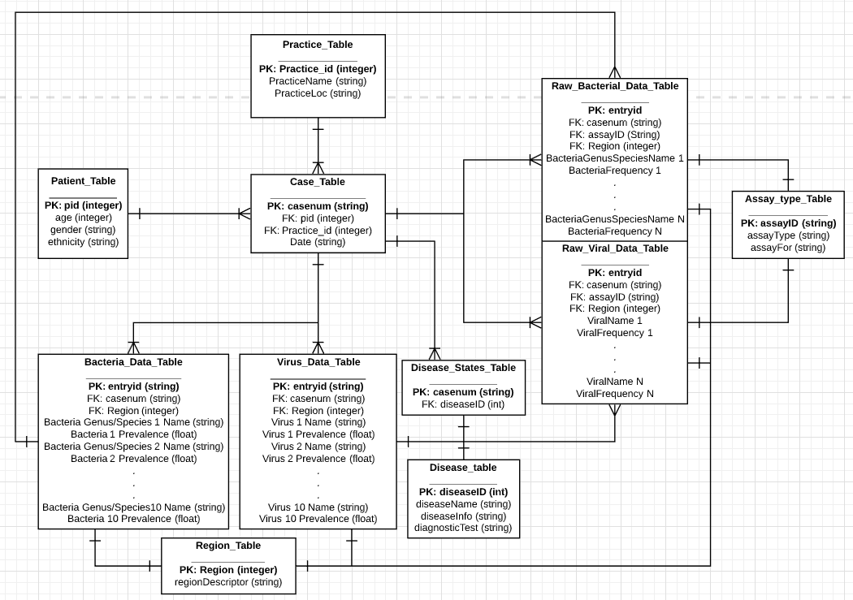


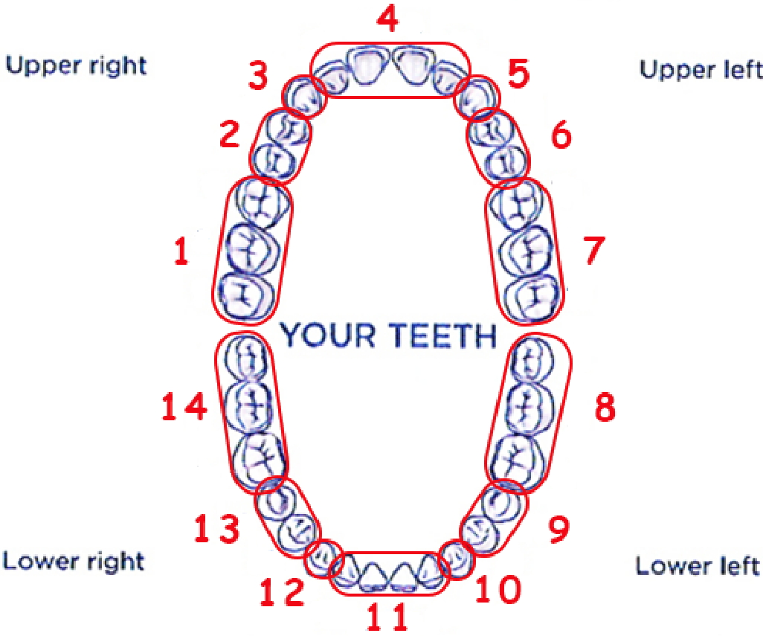


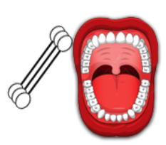
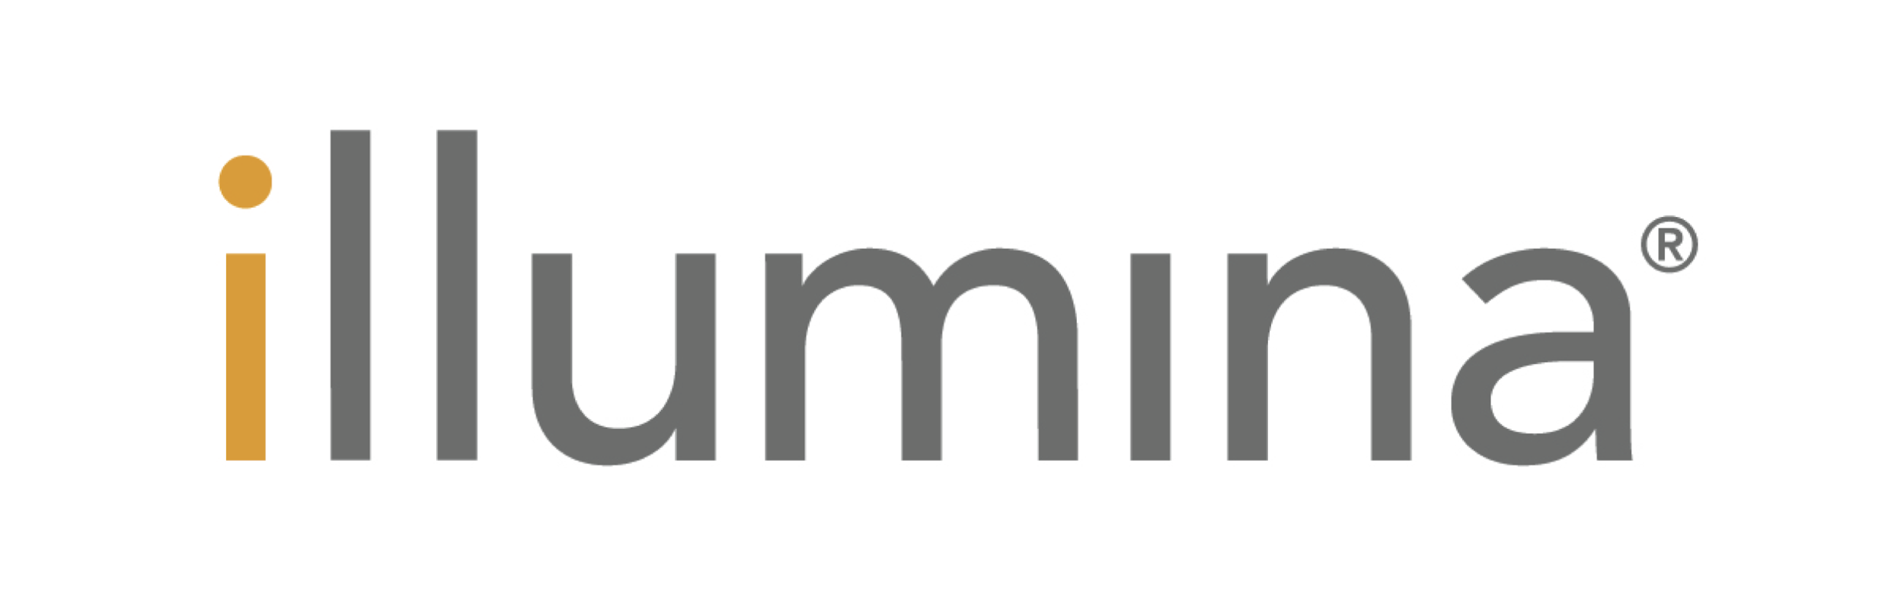

Q-Tip Diagnosis
The Potential of Utilizing a Database of 16S-RNA Assays of Oral Samples to Diagnose Oral Diseases
Gatphan Atassi, Dr. Jennifer Weller
Department of Bioinformatics and Genomics, University of North Carolina at Charlotte, Charlotte, NC 28223
Abstract
Methods
The past 25 years have seen a rapid introduction and wide-spread implementation of diagnostic and cyber-information technologies in the medical and dental professions. These advancements have enabled more advanced detection and diagnosis of ailments in patients. However, these instruments and technologies can cost the practice, hospital, and patient more money than they can afford. In recent years, discussions have been held into linking microbiomes and the presence of certain bacteria and viruses in non-intrusive regions of the body. As such, This project’s goal is to pioneer a new early diagnosis method based on the creation of a database of oral 16S assay data. A star model database was used giving each patient a case number. Each Patient had 14 different samples collected from the gum lines. These samples would be run through 16S Sequencing. The data used was procedurally generated, key points can be made. When querying the generated data tables, there was a realization that, with real data, some fairly powerful conclusions that could be made. This is powered by the ability to combine/split data on lines of race, gender, and age. This has potentially tremendous power given the input data. This does bring about one of the issues with this study. Accumulating the (real) data needed to make this an effective tool may prove to be tricky as is the safety of the personal data acquired. As such, if such obstacles are overcome, this tool can open up a new field of diagnostic medical care.
It is planned to construct a database wherein individuals oral data are tracked anonymously through a database. The database will be organized in a star model-esque design. For exact specifications on the database construction, consult the schema (Figure A). A few notes regarding these documents are to be addressed here, however. At this moment, gender is classified binarily. Future endeavors may expand the gender field to encompass non-binary people, but I believe this to beyond the scope of this experiment. Additionally, Each patient will have only 1 case number indicating their only visit wherein data is collected. While the database itself may handle cases of multiple cases per patient, such a scenario is not planned for at this moment. A patient will be tested during only one session but this session may render multiple data points in relation to the regions of the mouth tested. This eliminates the possibility of a patient dropping out of the study after only a single session and still provides the necessary point data needed. For further organizational data regarding the database, please consult the project outline located in the github repository.
At this point one last clarification should be mentioned. Given the current COVID-19 pandemic, data acquisition may be an issue but a system of organization and analysis is possible to set up. To test the performance, synthetic data will be produced. It will have characteristics as similar to real data as feasible.
Figure A: (above) Database Schema
Conclusions
Figure B: (Left) This Diagram of the arrangement of the teeth forgoes the typical dental numbering of each tooth for the numbering of the regions based on location and tooth type. These numbers represent the regions and are accurate to their representation in the model.
Although the data used in this internship was procedurally generated as a proof of concept there are some valuable takeaways to be had. Firstly, when looking at the data tables and the queries I can push through the database, there are some fairly powerful conclusions that could be made if real data was collected/used. Being able to collate gender, race, age, oral region, disease state, etc to analyze populations prevalence has the potential to open the door towards the expansion of preventative oral care and perhaps new diagnostic methods for whole body diseases. While no conclusions like that can be made with this project, what can be said is that the potential is clearly there to be expanded upon. There are some weaknesses however. Firstly, this tool can only be as powerful as the number of patients analyzed (which in itself presents personal information concerns that would need to be addressed). There is not a concrete number of patients that is currently known that would render this database as a viable tool. Additionally, this database would rely heavily on the strength of assays to identify taxa properly. This in itself adds another layer of potential weakness. Furthermore, this database has room to expand. Perhaps adding a geography field denoting where the data was collected. Additionally adding the nonbinary gender spectrum may be good route of expansion along side the current biological gender. All in all, I believe that there is a road where this project may deliver useful if not powerful data analysis but not without addressing some pertinent concerns.
Step 1: Patients who regularly get dental cleanings and operations at Dental Schools will be asked if they would be willing to participate in the study. Healthy and unhealthy (orally) will both be invited to the study.
Step 2: Those patients who were willing to be part of the study will have 14 gum level swab samples collected from each of the 14 regions outlined in Figure B.
Step 3: These samples are labeled, prepared, and run through Illumina 16S Sequencing to find traces of the most common Bacterial and Viral families and genuses.
Step 4: The output of Illumina Sequencing is parsed and organized using Python for database setup in SQL.
Github: https://github.com/colonialrebel/qtipdiagnosis/

